Slide 1
Engineering Physics Laboratory
(Course Code : PHY119)
Experiment - 3
AIM: To determine the Hall voltage and Hall coefficient by
using Hall effect.

Slide 2
Learning Objectives
1. To understand new phenomenon called Hall effect.
2. Variation of Hall voltage with magnetic field keeping current through specimen fixed and vice-versa.
3. To calculate various parameters of the given material like number density, mobility etc.

Slide 3

LET US START

Slide 4
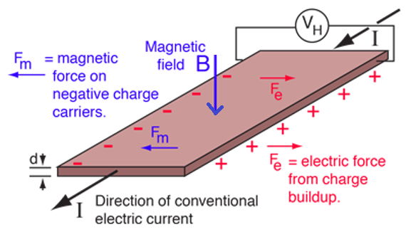
HALL EFFECT
The Hall effect is the production of a voltage difference (the Hall voltage) across an electrical conductor, transverse to an electric current in the conductor and to an applied magnetic field perpendicular to the current. It was discovered by Edwin Hall in 1879.

Slide 5
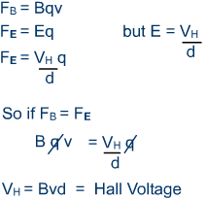
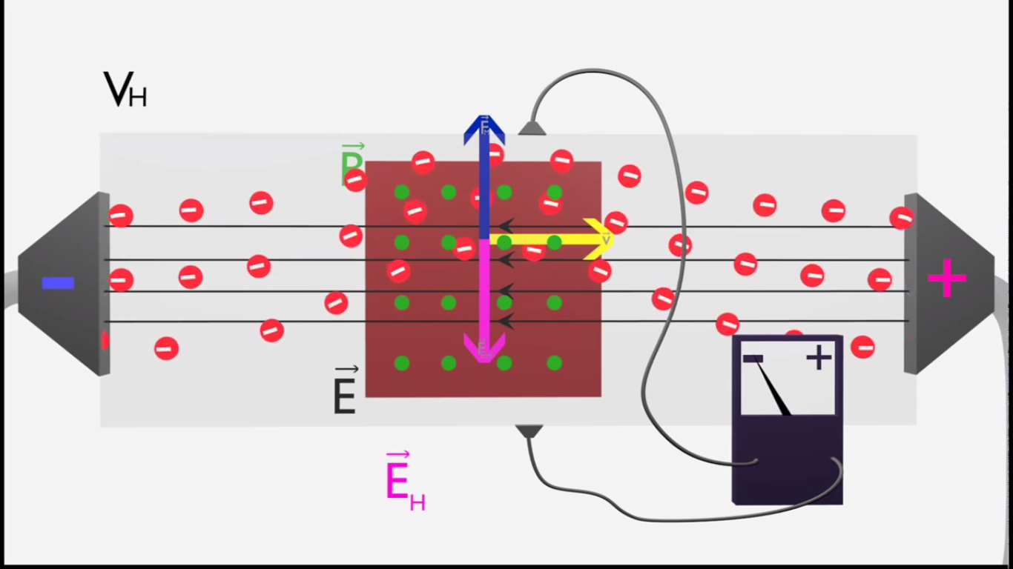
LORENTZ FORCE (Click)

Slide 6


Hall effect is a very useful phenomenon and helps to
Determine the Type of Semiconductor
By knowing the direction of the Hall Voltage, one can determine that the given sample is whether n-type semiconductor or p-type semiconductor. This is because Hall coefficient is negative for n-type semiconductor while the same is positive in the case of p-type semiconductor.
Calculate the Carrier Concentration
The expressions for the carrier concentrations of electrons (n) and holes (p) in terms of Hall coefficient are given by
OUR GOALS
Determine the Mobility (Hall Mobility)
Mobility expression for the electrons (μ_{n}) and the holes (μ_{p}), expressed in terms of Hall coefficient is given by,

Slide 7
A video illustrating Hall effect and its applications
On the next slide

Slide 8
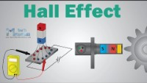

Slide 9
Check your understanding

Slide 10
Check your understanding
Q
Q3.1: In the Hall Effect, the directions of electric field and magnetic field are parallel to each other.
The above statement is
a) True
b) False

Slide 11
Check your understanding
Q
Q3.2 : Which of the following parameters can be found with Hall Effect?
a) Polarity (n or p-type)
b) Conductivity
c) Carrier concentration
d) All of these.

Slide 12
Check your understanding
Q
Q3.3: In the Hall Effect, the electric field is in x direction and the velocity is in y direction. What is the direction of the magnetic field?
a) X
b) Y
c) Z
d) XY plane

Slide 13
Check your understanding
Q
Q3.4: In Hall effect, the force responsible for the separation of charge carriers which results in Hall voltage is
a) Coulomb force
b) Gravitational force
c) Lorentz force
d) Nuclear force

Slide 14
Check your understanding
Q
Q3.5: In Hall Effect, the electric field applied is perpendicular to both current and magnetic field?
a) True
b) False

Slide 15
Step by Step guide to perform the experiment in Virtual lab
Follow the slides below.

Slide 16
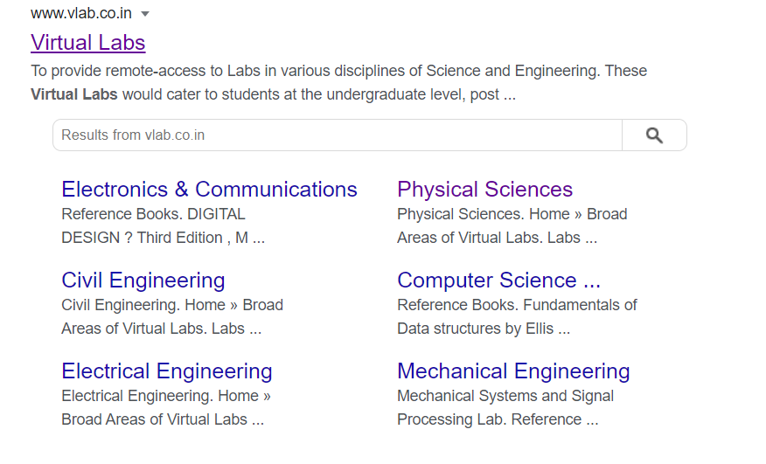
Type this link on the address bar or Click on this link : https://www.vlab.co.in/

Slide 17
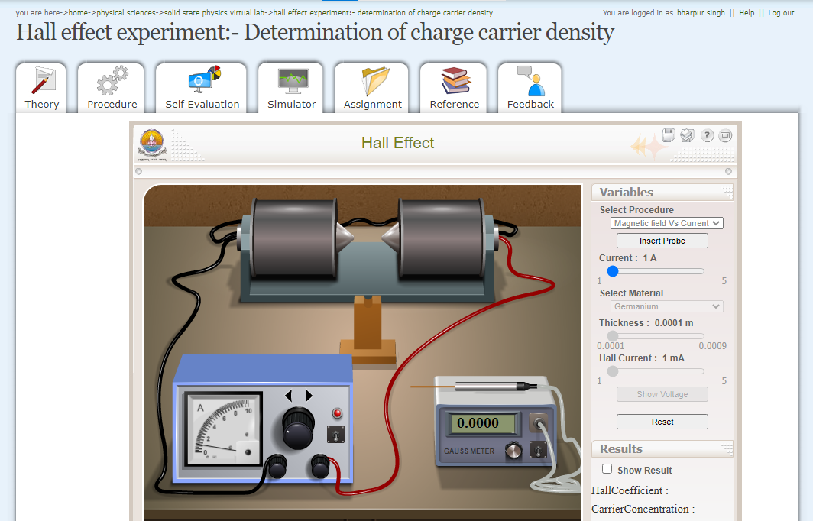
Click on the simulator

Slide 18
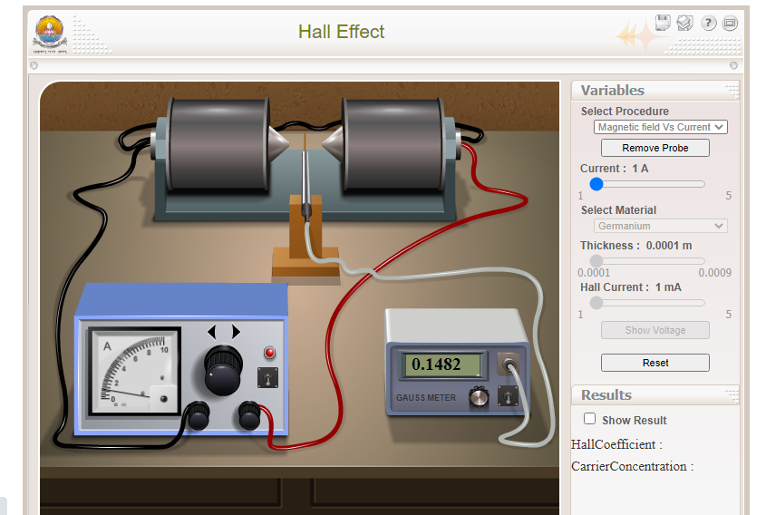
Selection of variables in simulation
Under Select procedure
Select Magnetic field Vs Current
Click insert probe
Click wooden block to place probe into the magnetic field
Vary the current and note down the value of magnetic filed in the Gauss meter.
Make a table of current Vs. magnetic field.

Slide 19
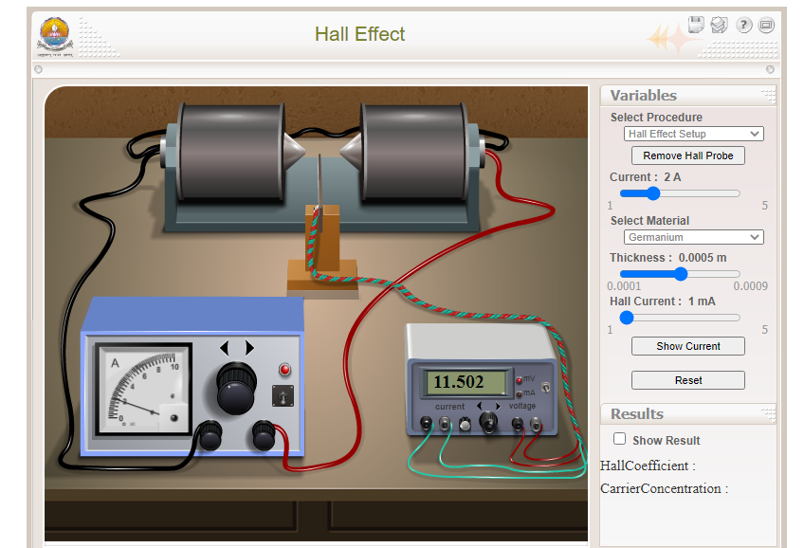
Now let us measure the Hall voltage, do the following.
Under Select procedure
Select Hall effect setup
Click insert Hall probe
Click wooden block to place probe into the magnetic field
Select current through electromagnet at any desired value.
Select material as Germanium and thickness as 0.0005m
Vary the Hall current and note down the value of Hall voltage in the meter.
Make a table of Hall current Vs. Hall voltage.
Calculate Hall coefficient and other parameters from the data.

Slide 20
Activity Based Polling
while the students perform the experiment in virtual lab

Slide 21
A
A3.1: Measured value of the magnetic field when current of 3.5 amperes passes through the electromagnet is
a) 0.5188 Tesla
b) 34.507 Tesla
c) 5.188 Tesla
d) 0.34507 Tesla

Slide 22
A
A3.2: Measured value of the Hall voltage for germanium sample, when a current of 2 mA passes through it and placed in perpendicular magnetic field of 0.4447 Tesla. Take thickness of the specimen to be 0.5 mm.
a) 22.607 mV
b) 34.507 mV
c) 2.2607 mV
d) 3.4507 mV

Slide 23
A
A3.3. Calculate the carrier concentration for semiconductor (Ge) of thickness 0.3mm. (As per simulator)
3.22 X 10^20
4.55 X 10^20
6.55 X 10^20
2.46 X 10^20

Slide 24
Check your understanding
Q
Q3.4: Calculate manually the Hall Effect coefficient when number of electrons in a semiconductor is 10²⁰.
a) 0.625
b) 0.0625
c) 6.25
d) 62.5

